Slide 1
US Accidents Exploratory Data Analysis
By Zahid Shaikh

Slide 2
Talks about US Accidents (2016 - 2023) data set with approximately 7.7 million accident records
Source – Kaggle
What it contains - Countrywide car accident dataset that covers 49 states of the USA from February 2016 to March 2023
How it will be useful - Can be useful to prevent accidents
This data does not contain data for New York

Slide 3
Below are the libraries used for this Project
Pandas – used for analyzing, cleaning, exploring, and manipulating data
Opendatasets – used to download dataset from kaggle
Seaborn – used for making statistical graphics in Python
Matplotlib – used to create static, animated, and interactive visualizations
Folium – used to create several types of Leaflet maps

Slide 4
This project revealed the following insights:
Only a small fraction (10.8%) of cities had over 800 accidents.
A large number of cities (1023) reported a single accident.
Miami had the most accidents (186,917), accounting for about 2.418% of all car accidents in the USA.
California has the most car accidents in the USA, with 1,741,433 incidents in the data. This accounts for 22.53% of all the car accidents in the country.
There is an exponential decline in the car accidents across different cities.
The peak hours for car accidents are 6-10am and 1-5pm, which have the highest percentages of incidents.
Weekends have the fewest car accidents, possibly due to less traffic than weekdays.
The peak hours for accidents vary depending on the day of the week. On weekdays, most accidents happen between 7 and 8 in the morning, while on weekends, they are mor likely to occur between 3 and 5 in the afternoon
There is a seasonal trend in the number of accidents in the US, with a sharp increase from August onwards. The winter months of December, January and November have the highest rates of accidents, possibly due to the weather conditions.

Slide 5
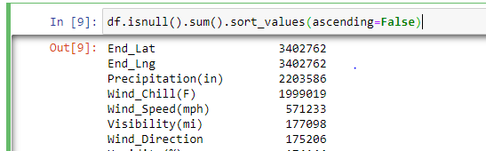
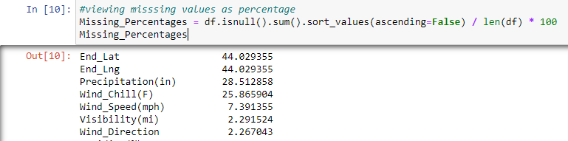
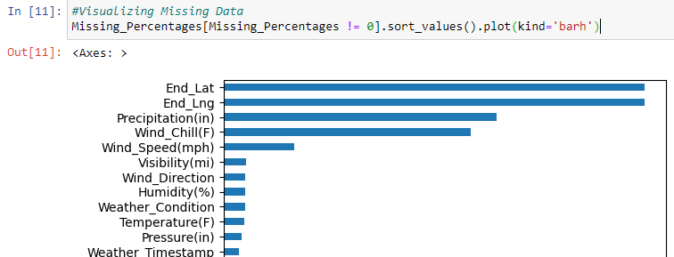
Identifying the presence of null values in the data
Checking for missing data in the dataset
Calculating the percentage of missing data for each variable
Plotting the missing data to determine which variable has the most null values

Slide 6


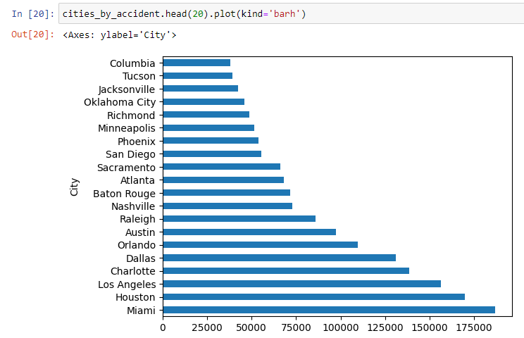
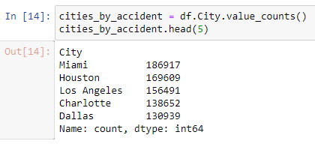
Calculating the diversity of cities in the dataset
Calculating the proportion of accidents that happen in the most accident-prone city which is Miami
Checking the top 5 cities where the most accidents occurred
Creating a chart to show the accident frequency in the top 20 cities

Slide 7
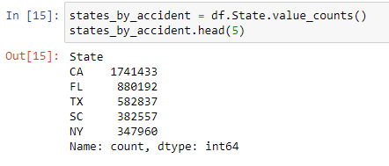

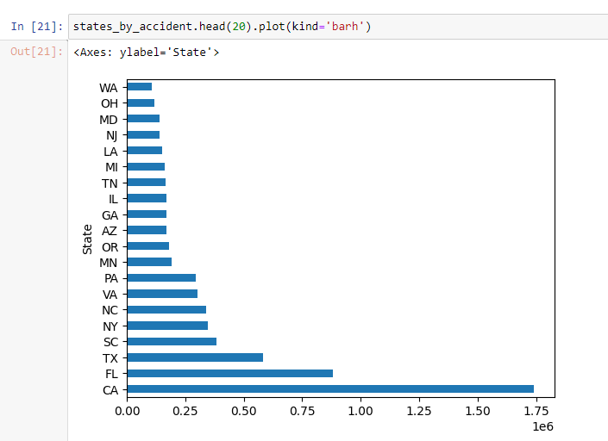
Analyzing the distribution of accidents across different states and identifying the top 5 states with the highest frequency of accidents
Calculating the proportion of accidents that happen in the most accident-prone state which is California
Creating a chart to show the accident frequency in the top 20 states

Slide 8
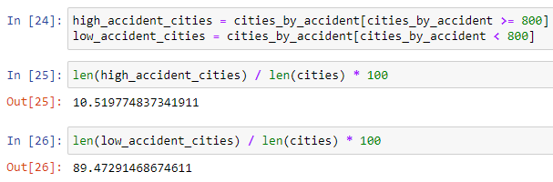
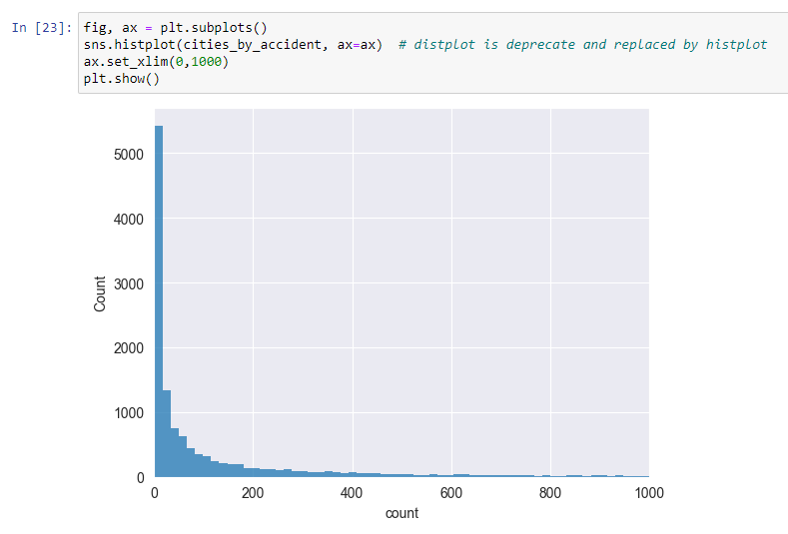
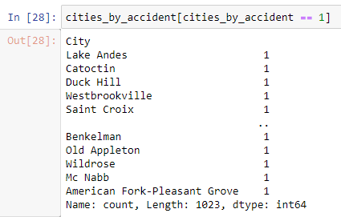
Only a small fraction (10.8%) of cities had over 800 accidents.
There is an exponential decline in the car accidents across different cities.
A large number of cities (1023) reported a single accident.

Slide 9
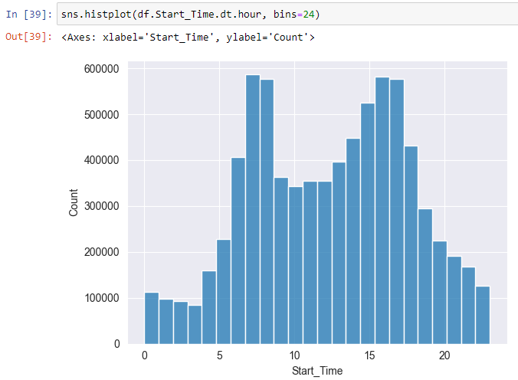
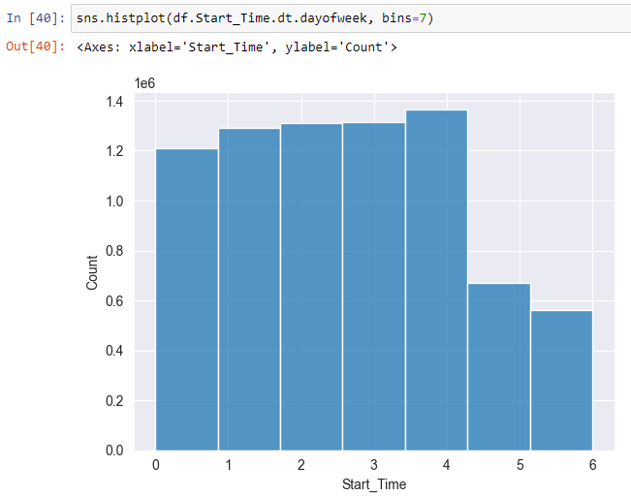
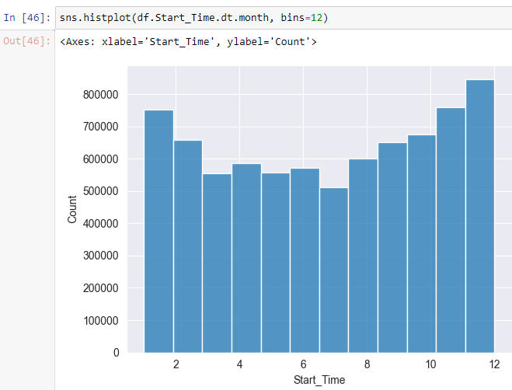
Avg number of accidents on hourly basis
Avg number of accidents based on days of the week
Avg number of accidents on monthly basis

Slide 10

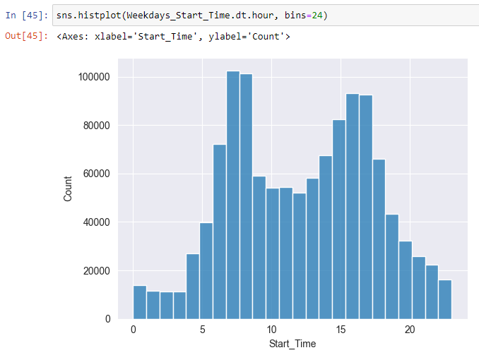
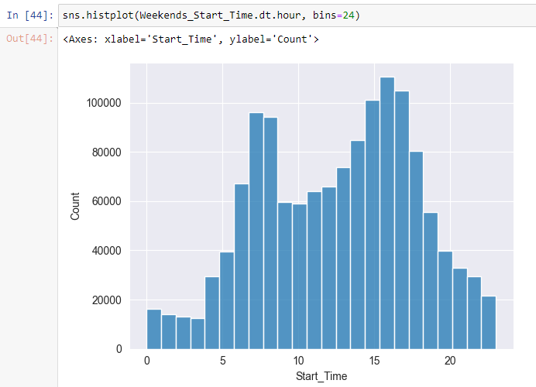
This function converted the week data into two groups: weekday and weekend
On weekdays, most accidents happen between 7 and 8 in the morning
On weekends, they are mor likely to occur between 3 and 5 in the afternoon

Slide 11
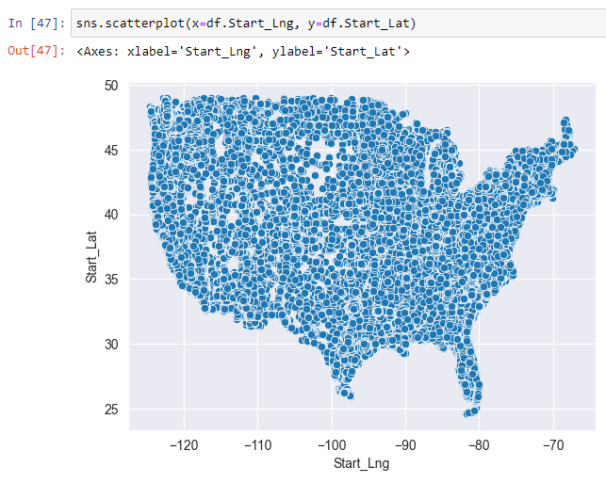
A scatterplot of the Start_latitude and longitude of the accidents showed an outcome that looked like a US map.

Slide 12
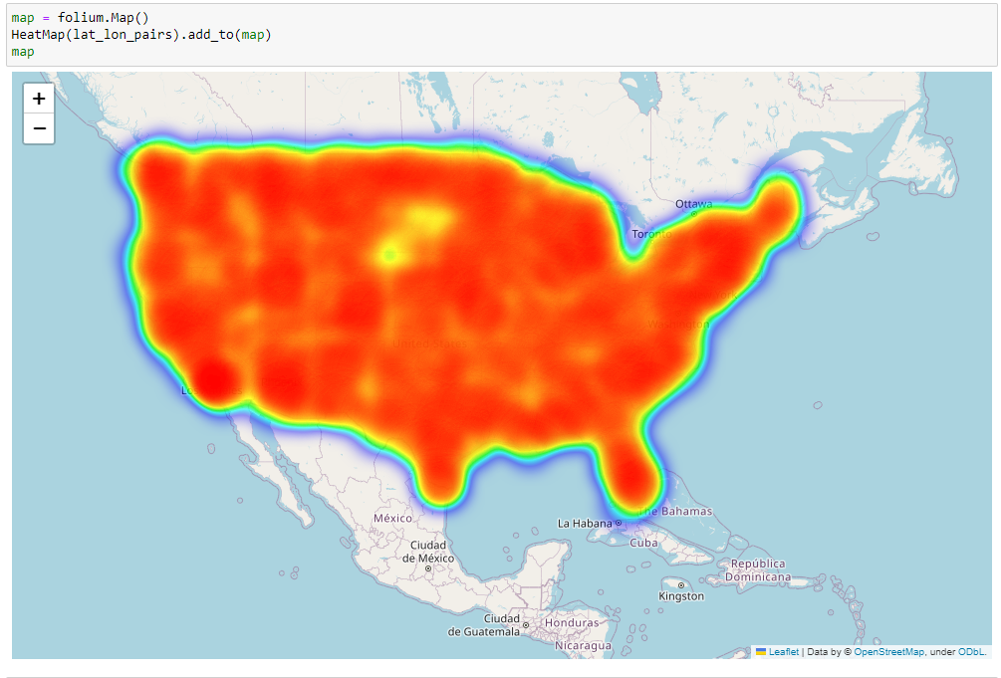
To generate a heatmap of the start latitude and longitude of the accidents, I used folium and converted the dataset to 50% sample data, as the original dataset was too large.

